Slide 1

Time Management
PRESENTED BY:
ANKIT TIWARI

Slide 2
Agenda
01 | Why Time management matters ?
02 | Common Time Wasters
03 | Situation becomes odd if you don’t manage time
04 | Activity Time
05 | Smart Time Management Techniques

Slide 3

Why Time Management Matters
Boosts productivity and efficiency
Reduces workplace stress
Helps achieve career goals
Balances personal and professional life

Slide 4
Common Time Wasters
Unplanned meetings
Social Media
Constant email checking
Lack of planning

Slide 5
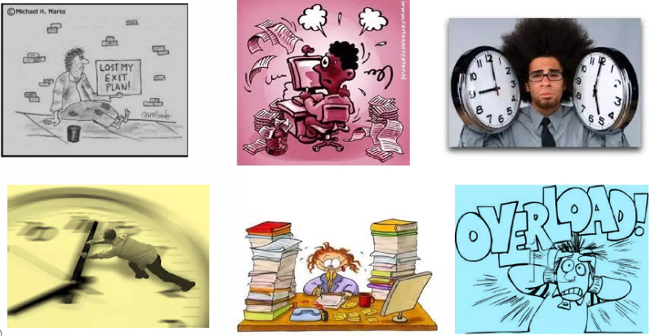
The situation becomes odd… if you don’t manage time…

Slide 6

Activity Time
How Long is a minute ? How Long Is a Minute? | PBS LearningMedia

Slide 7
Smart Time Management Techniques
Plan your day
Prioritize
Focus
Review

Slide 8
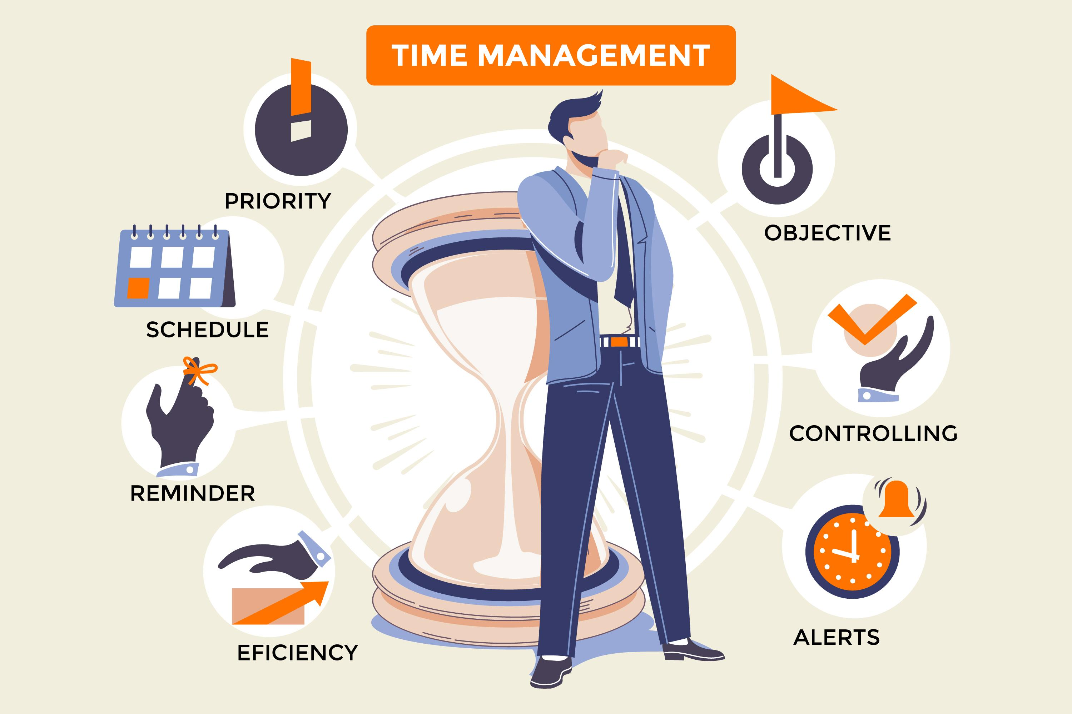
Tips & Tricks

Slide 9

Conclusion
By setting clear goals, prioritizing wisely, and staying disciplined, we can achieve greater productivity, reduce stress, and create more time for what truly counts.

Slide 10
Thankyou

